Slide 1

1 a.m.u. and energy equivalent to
1 a.m.u.

Slide 2
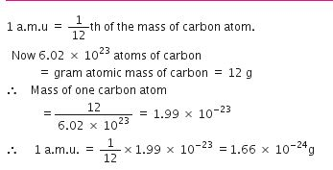

Slide 3
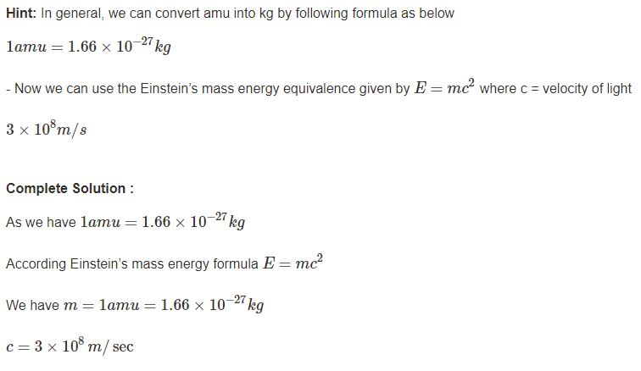

Slide 4
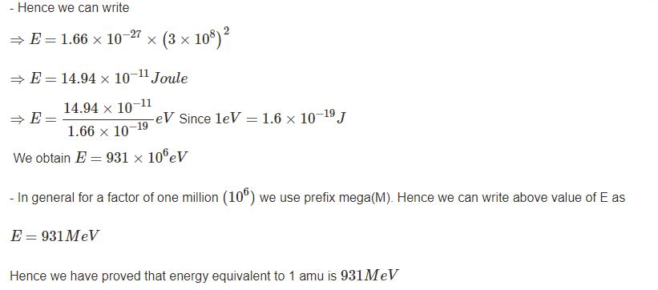

Slide 5
EXERCISE
Compute the energy equivalence of 1g in KWh
Compute the energy equivalence of 1kg in KWh
What is the ratio of KWh and MeV

